Slide 1


Getaround Analysis
Deployment

Slide 2
Context
Tasks
Problem: Car rental cancellation on Getaround platform
Analyze the effect of a rental delay buffer on both checkin methods
Produce a web dashboard to assist the decision (scope, minimum delay)
Reason: Late car returns cause friction if next user has to wait
Train car pricing optimization models
Proposition: Introduce a buffer delay between consecutive rentals
Provide access to these models through an API endpoint
Also need a car pricing model available through an API
Include the car rental pricing functionality in the web dashboard

Slide 3












Pipeline architecture
Delay analysis data
Dashboard
API
EDA
Tracking server
Servers deployment on
Training
Pricing data

Slide 4
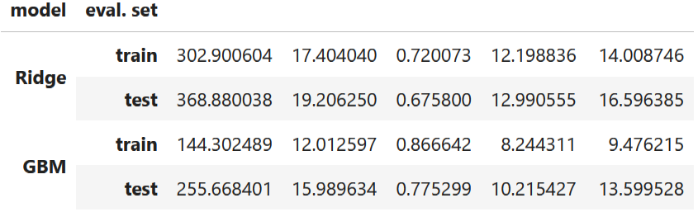
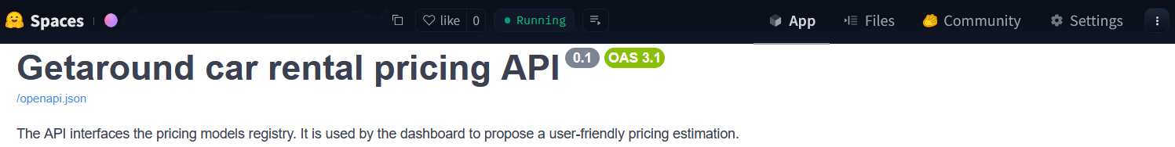
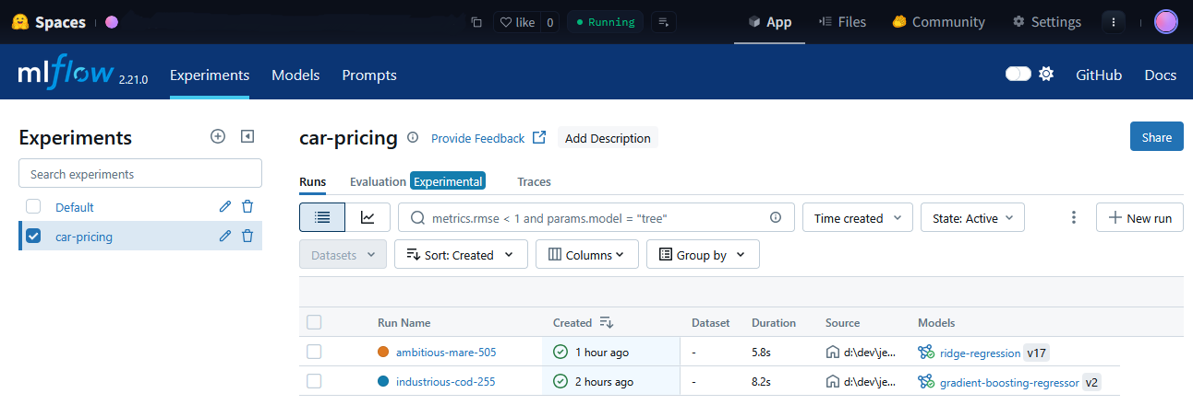
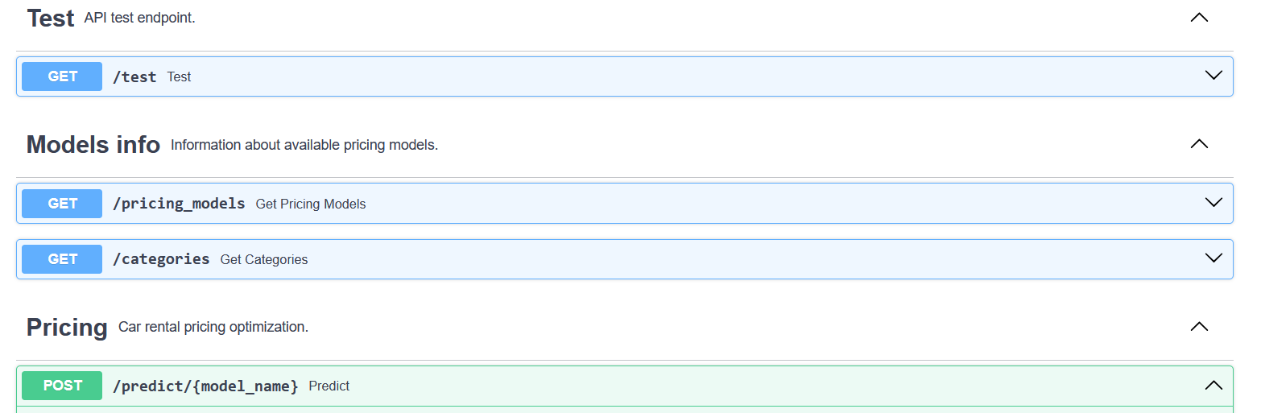
Pricing optimization API
Two pricing models
Ridge regression (Ridge)
Gradient boosting model (GBM)
Model training and tracking
Setup pricing API
Dispatch training on AWS EC2 instances
(MLflow project)
Registered models prediction endpoint
Provides additional model information
Track and record models in Mlflow server

Slide 5
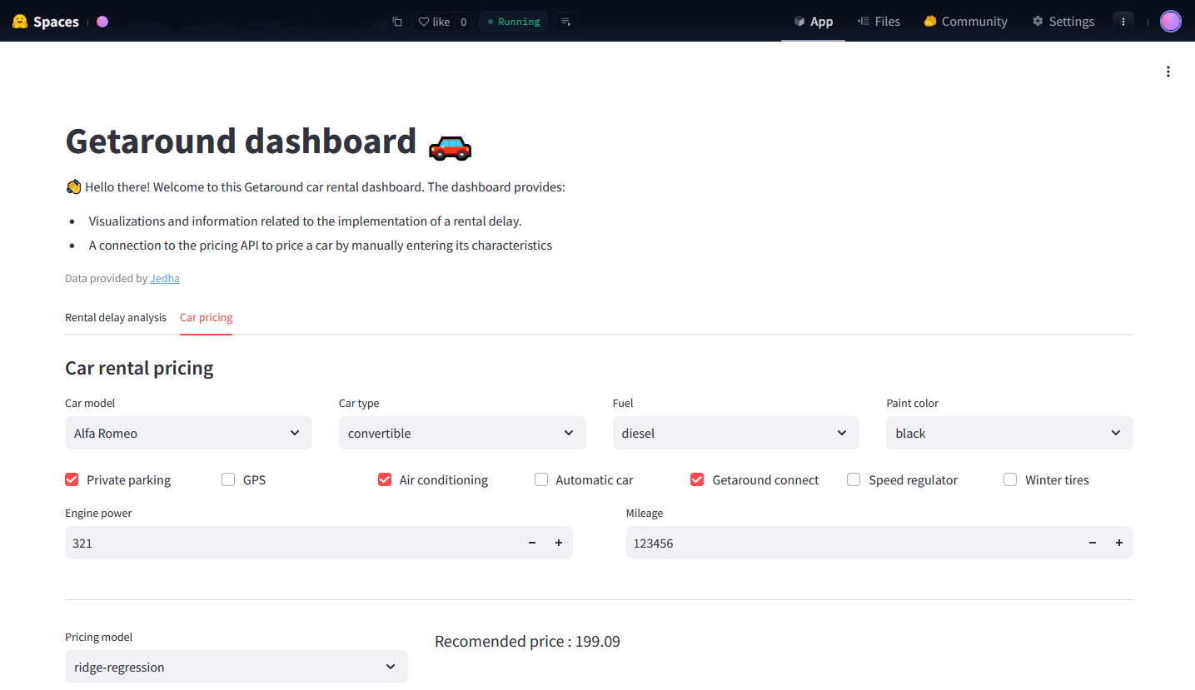
Dashboard : car rental pricing
Check API availability at startup
Fetch models info
Pricing evaluation from user input
(/predict endpoint)

Slide 6
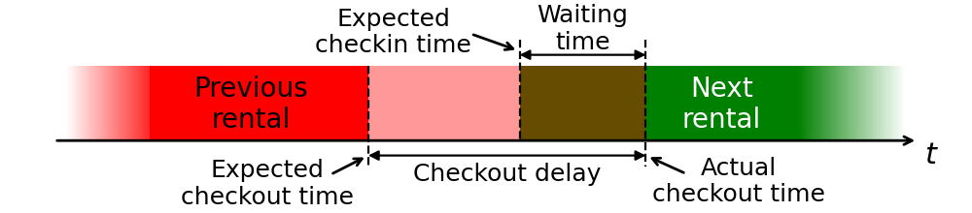
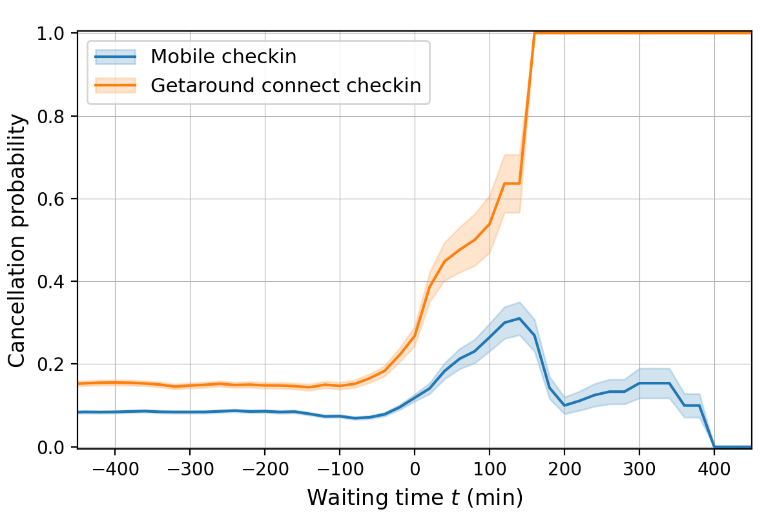
Rental delay analysis
Cancellation probability
Depends on waiting time
Depends on the checkin method
(Getaround connect or mobile)
Late car return problem
Previous user is late
Car return delay may overlap with next rental
Creates friction if next user has to wait

Slide 7
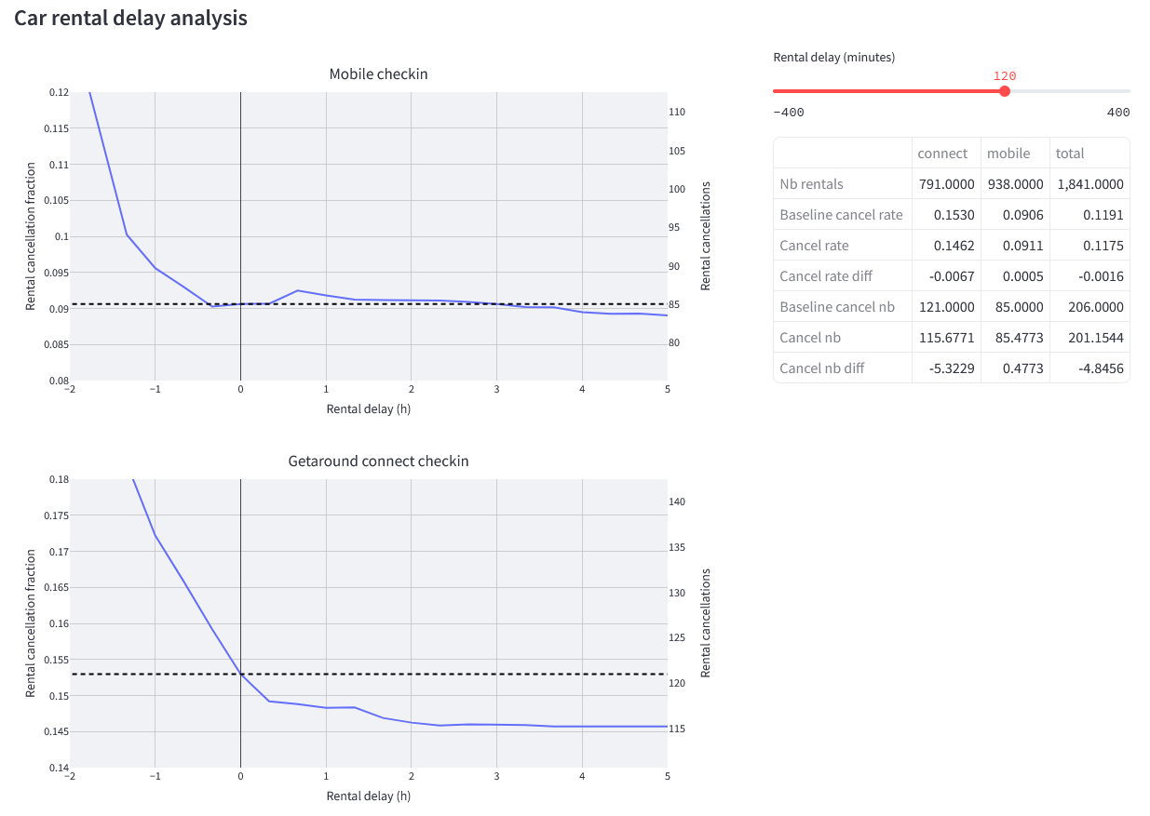
Dashboard : rental delay analysis
Visualize the effect of a rental delay
Cancellation probability
Both checkin methods
Summary table
Rental delay slider
Quantitative insights

Slide 8

Thanks!

